Slide 1
Refine the success
Louis, Sweta, Albert

Slide 2
First version of Definition of success
If final position is in the sphere centered at the (0,0,0) with radius 0.04, then it is successful.
Where (0,0,0) is the position of max value should be, sigma is 1

Slide 3
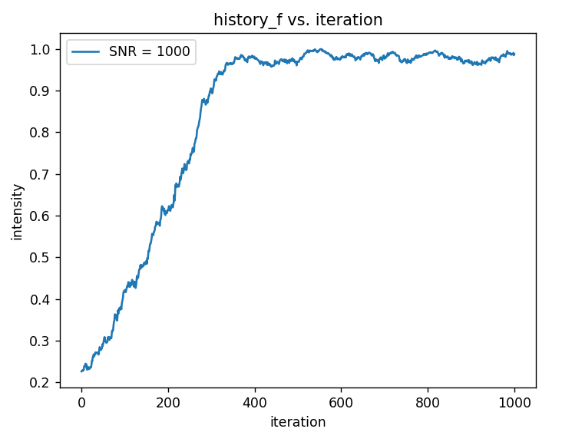
Second version of Definition of success
The value goes into the band and keeps 50 percent time within the band from the starting point to the end of iteration.
The starting point is the first time the average value of 10 consecutive iterations goes within the band.
The band is >0.9*max=0.9

Slide 4
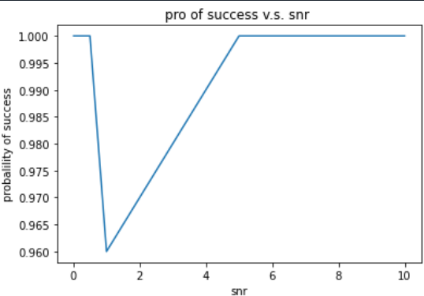
Problems of Second version
The band is lower limited, but not upper limited
However, it’s not unfair for lower SNR
It’s easy for lower SNR to get a higher value
For example, if SNR=0.01, noise is too large and easy to get a higher value than 1

Slide 5
Why PSO seems reasonable?
The probability of PSO algorithm when SNR ==small values is 0.5 while GS is around 1?
How temporary PSO works?
Particles are generated randomly in the sphere centered at (0,0,0), with radius of sqrt(3)
Particles move until 1000 iterations
Get the average position of all particles, note that PSO only needs around 100 iterations to get a good value, so PSO might converge right now
Put the output position into function noisy_gaussian to calculate the value

Slide 6
Third version of Definition of success
Position matters & Stability
The value goes into the successful sphere and keeps 50 percent time within the band from the starting point to the end of iteration.
The starting point is the first time searching point goes into the successful sphere. (no noise, so no average 10 iteration)
The temporary successful sphere is defined as center (0,0,0), with radius of 0.225
In real experiment, lets assume that our sigma is ~300nm. In that case the saturation of intensity occurs over ~40nm, which is ~0.13 time of sigma. 0.13 in x, 0.13 in y and 0.13 in z. so the position value will actually be 0.13*root 3 = 0.225

Slide 7
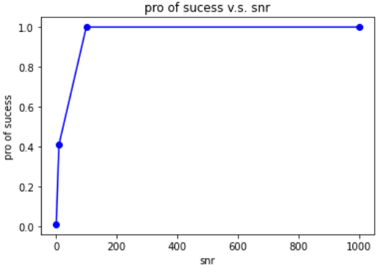
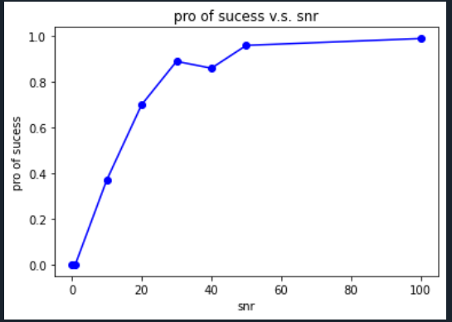
PSO of third version

Slide 8
Next goal: Optimized GS and PSO
Optimize GS’s parameters, including step size and gradient search
Optimized PSO’s parameters
Optimized PSO algorithm
PSO is famous for its simple computing process and surprising output
But here we don’t care about fasting the speed of computing. We could apply machine learning methods here or apply some algorithm from recent papers

Slide 9

Thanks

